Slide 1
Predicting performance drops without ground truth labels
Results summary (simulating 3 drifts)
2nd NOVEMBER 2023

Slide 2
Methods

Slide 3
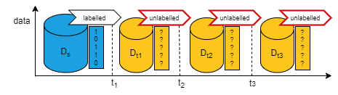
Unlabelled batch learning scenario

Slide 4
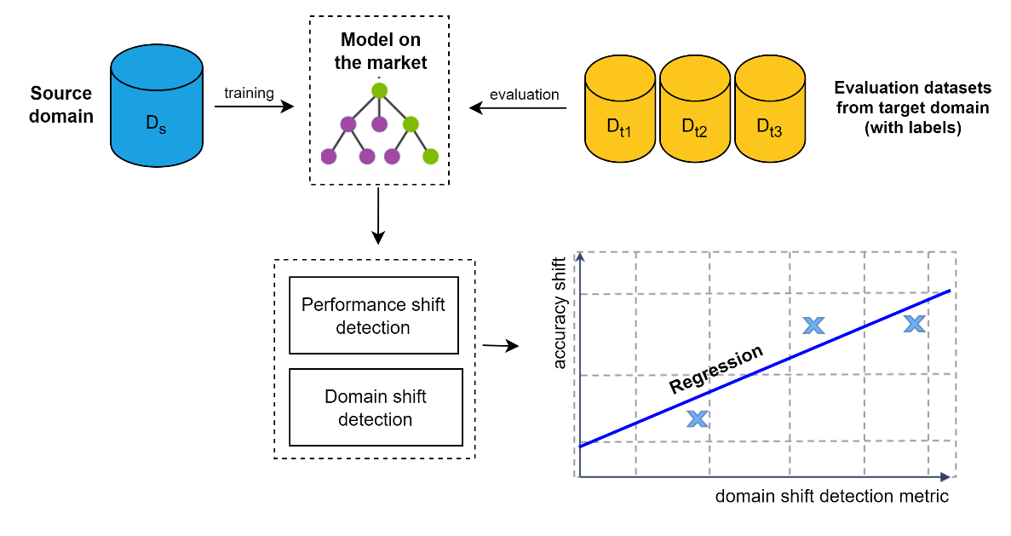
Regression of performance shift (on labelled sets)

Slide 5
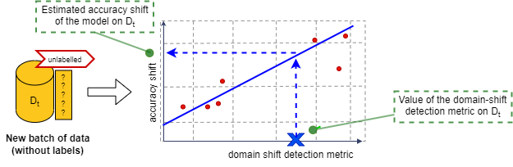
Prediction of performance shift (on new unlabeled set)

Slide 6
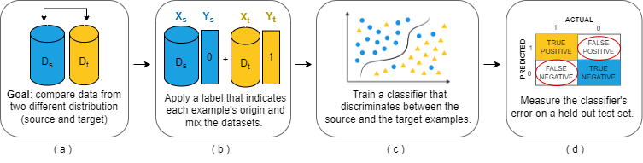
Metrics to predict performance shift
1) Discrimination error

Slide 7
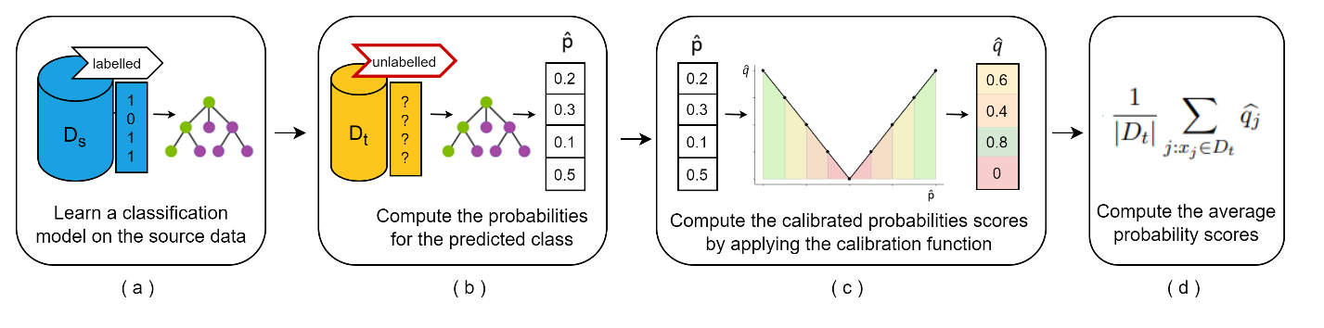
Metrics to predict performance shift
2) Average certainty score (AVRS)

Slide 8
Results Simulated data (AGRAWAL)

Slide 9
AGRAWAL generator
This generator consists of six numeric attributes and three categorical attributes to describe the hypothetical loan applications. For the numeric attributes, there is a perturbation factor that makes to shift the true value by adding an offset. It can produce ten different functions to determine whether the loan should be approved or not. The concept drift happens by changing the functions.
Reference: https://moa.cms.waikato.ac.nz/tutorial-5-simulating-concept-drift-in-moa/
Feature | Description | Type
salary | salary | continuous
commission | commission | continuous
age | age | continuous
elevel | education level | categorical
car | car maker | categorical
zipcode | zip code of the town | categorical
hvalue | house value | continuous
hyears | years house owned | continuous
loan | total loan amount | continuous
Dataset | Total instances | No. of classes | No. of drifts | Drift type | Drift width
Agrawal-100K | 100,000 | 2 | 3 | Gradual | 5,000
Future work: explore how the drift width and the batches window interact.

Slide 10
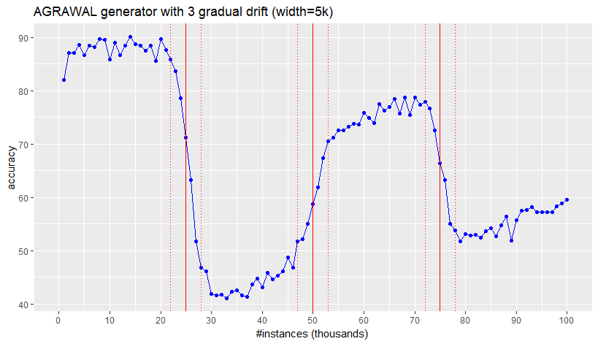
Simulated drifts (width = 5K) with AGRAWAL generator

Slide 11
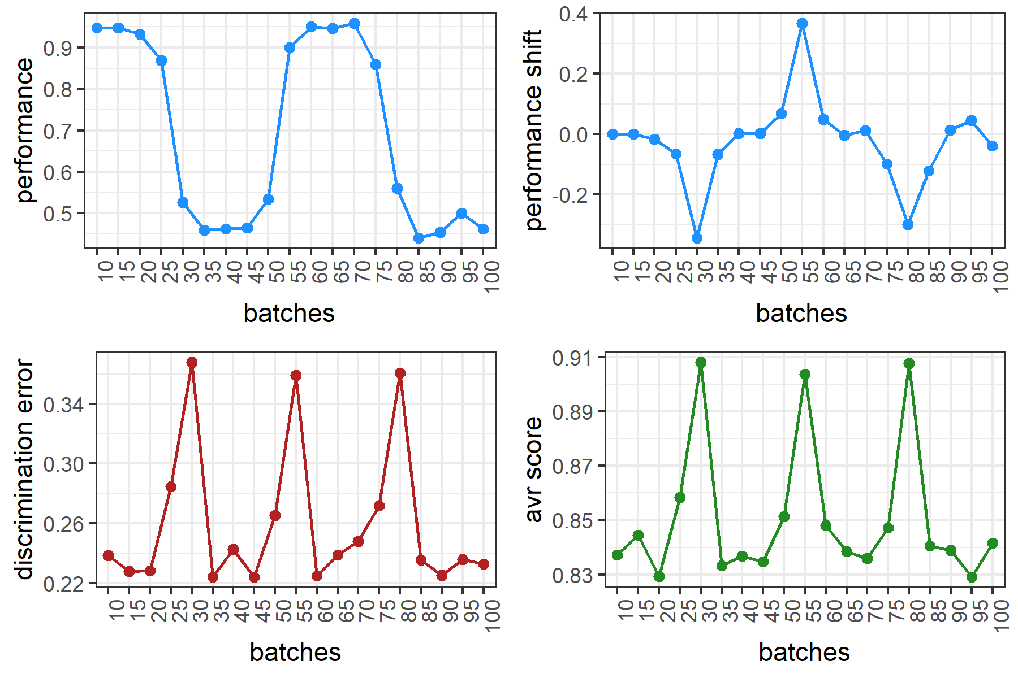
Simulated data (accuracy shifts)

Slide 12
Metrics computation
*both metrics can spot the drift. However, they cannot guess the direction of change.

Slide 13
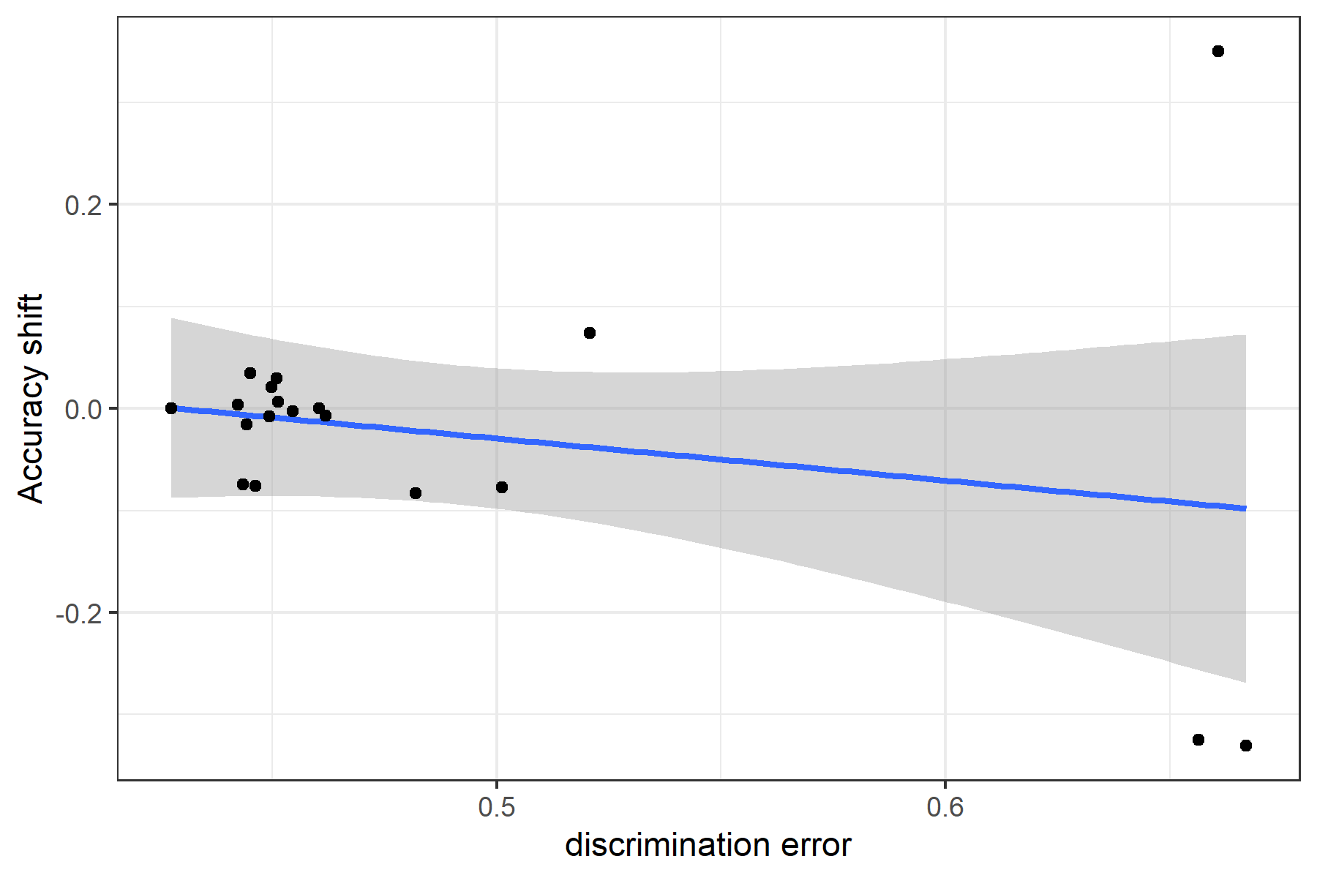

Regression models

Slide 14
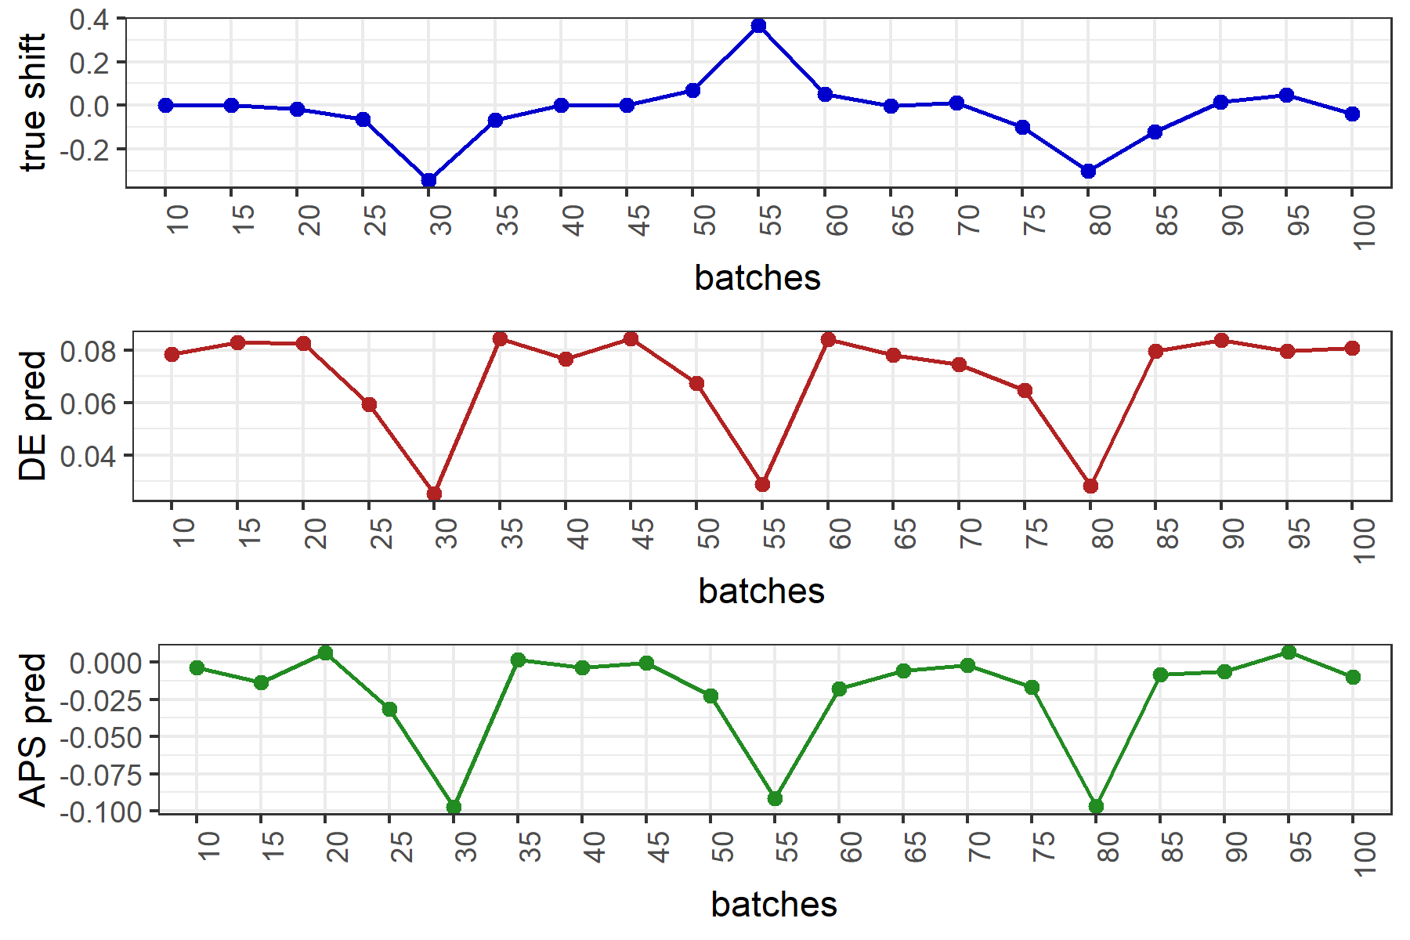

Shift prediction
*AVR score is the metric performing better in predicting the shifts.

Slide 15
Results Covid-19 data (accuracy, RF model)

Slide 16
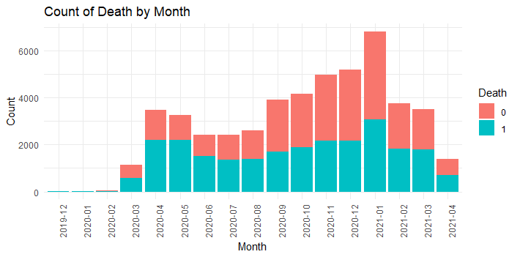
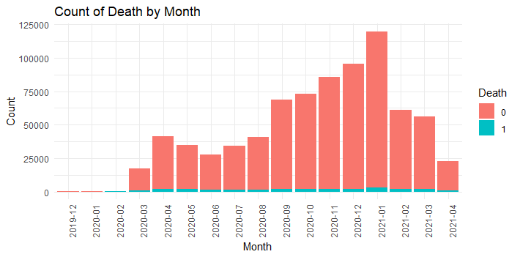
Balancing data
*Thought: we noticed that precision of the model over the batches was extremely low. We then decided to balance the data by under sampling the majority class (Death=0)
Original data
After under sampling majority class (death=0)

Slide 17
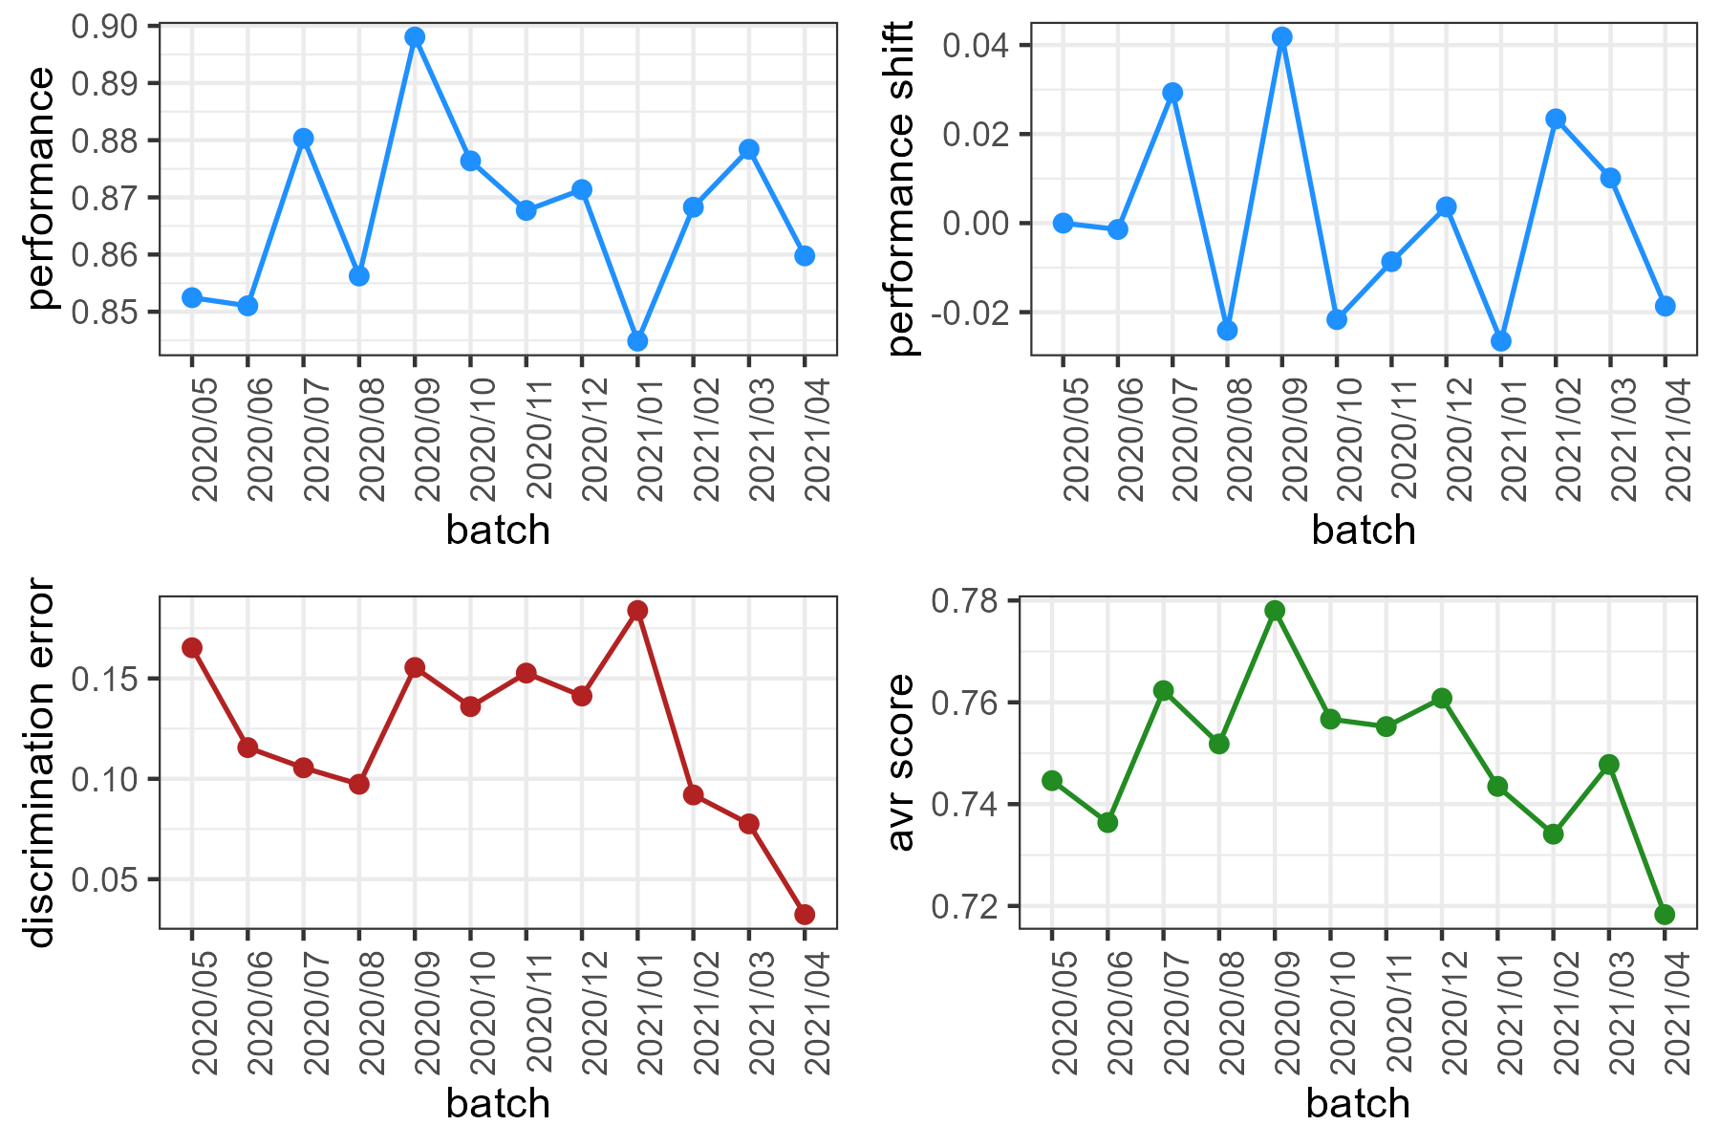
COVID-19 data (accuracy, RF model)

Slide 18
Metrics computation
*When DE decreases, the model easily split source data with target data, that is the domain are very different (indicates shift).
Same for the average certainty score.

Slide 19
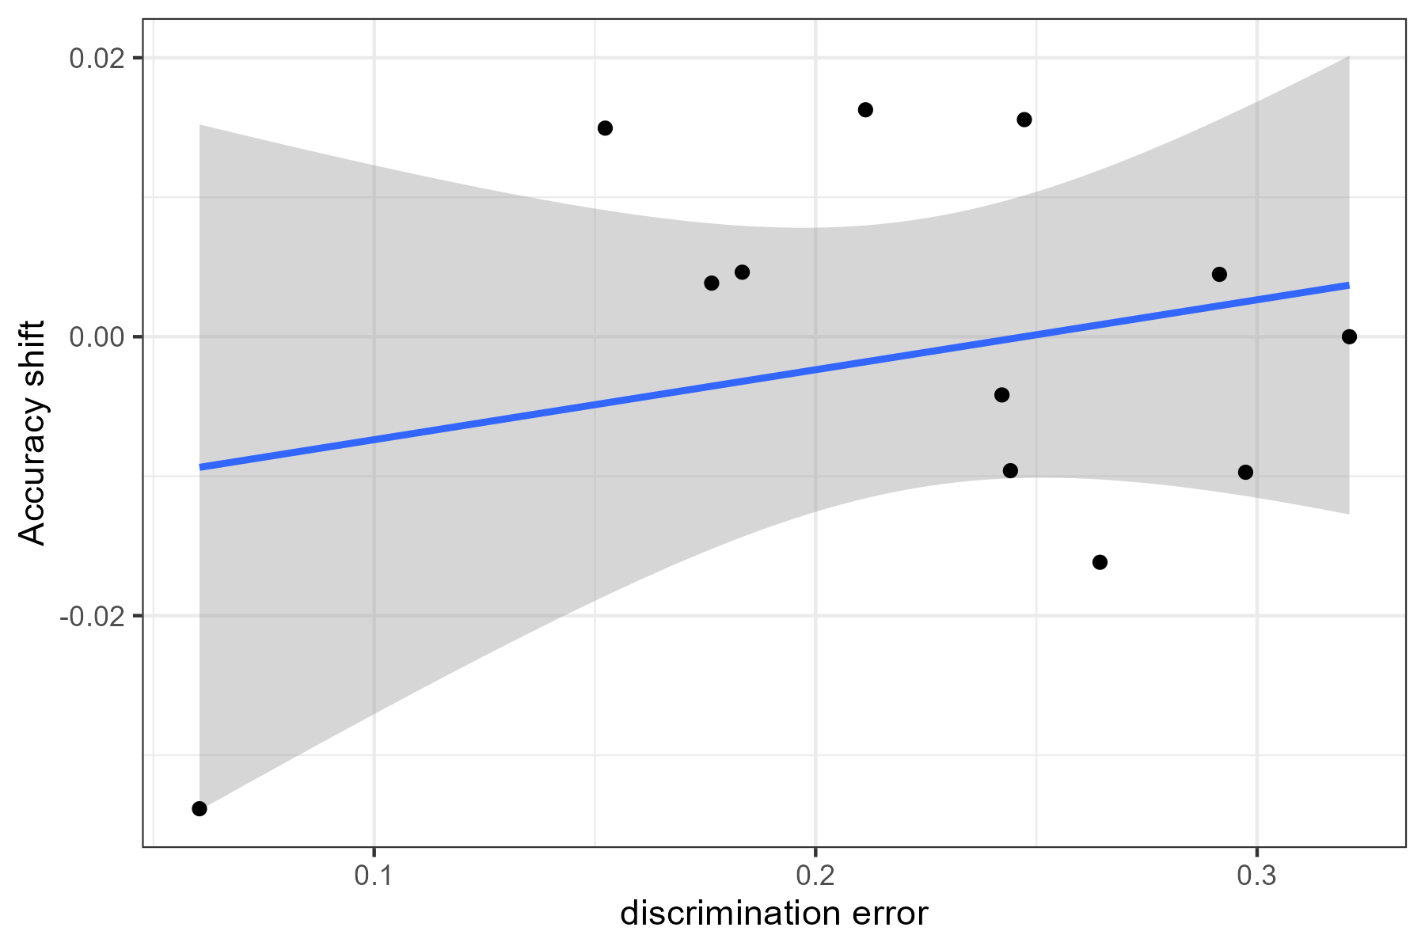
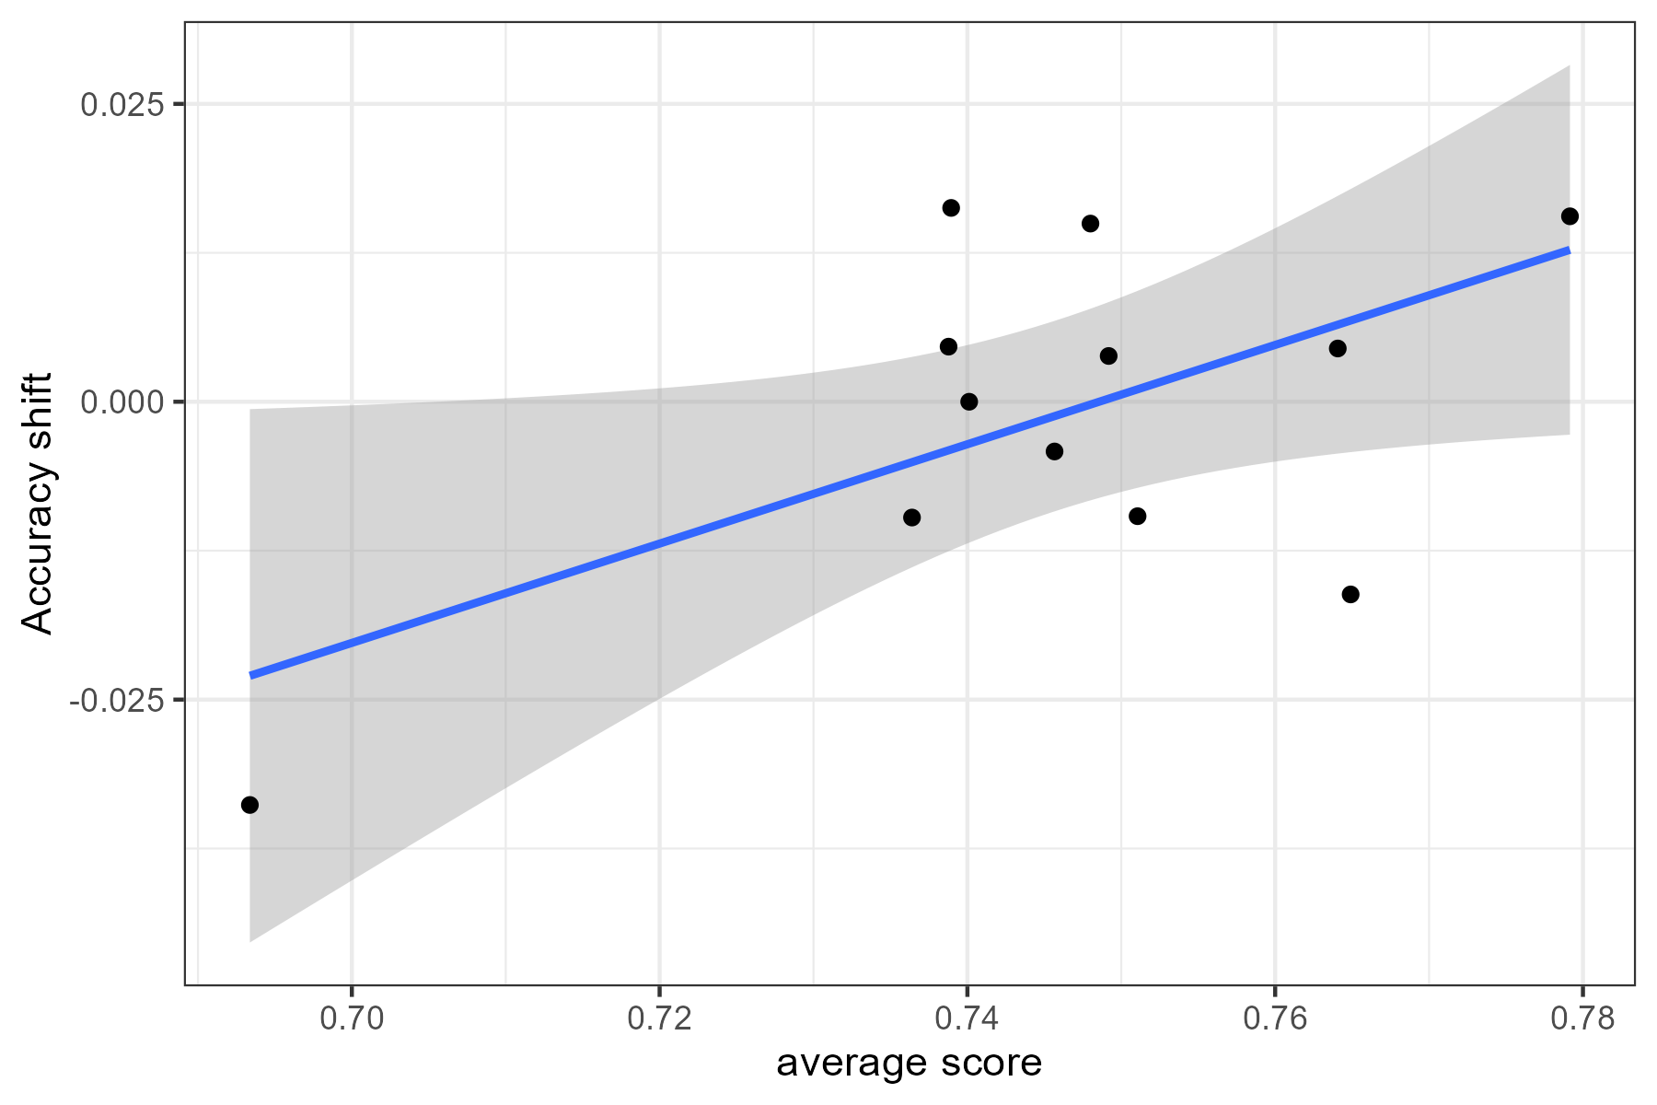
Regression models
*Positive correlation for both metrics.

Slide 20
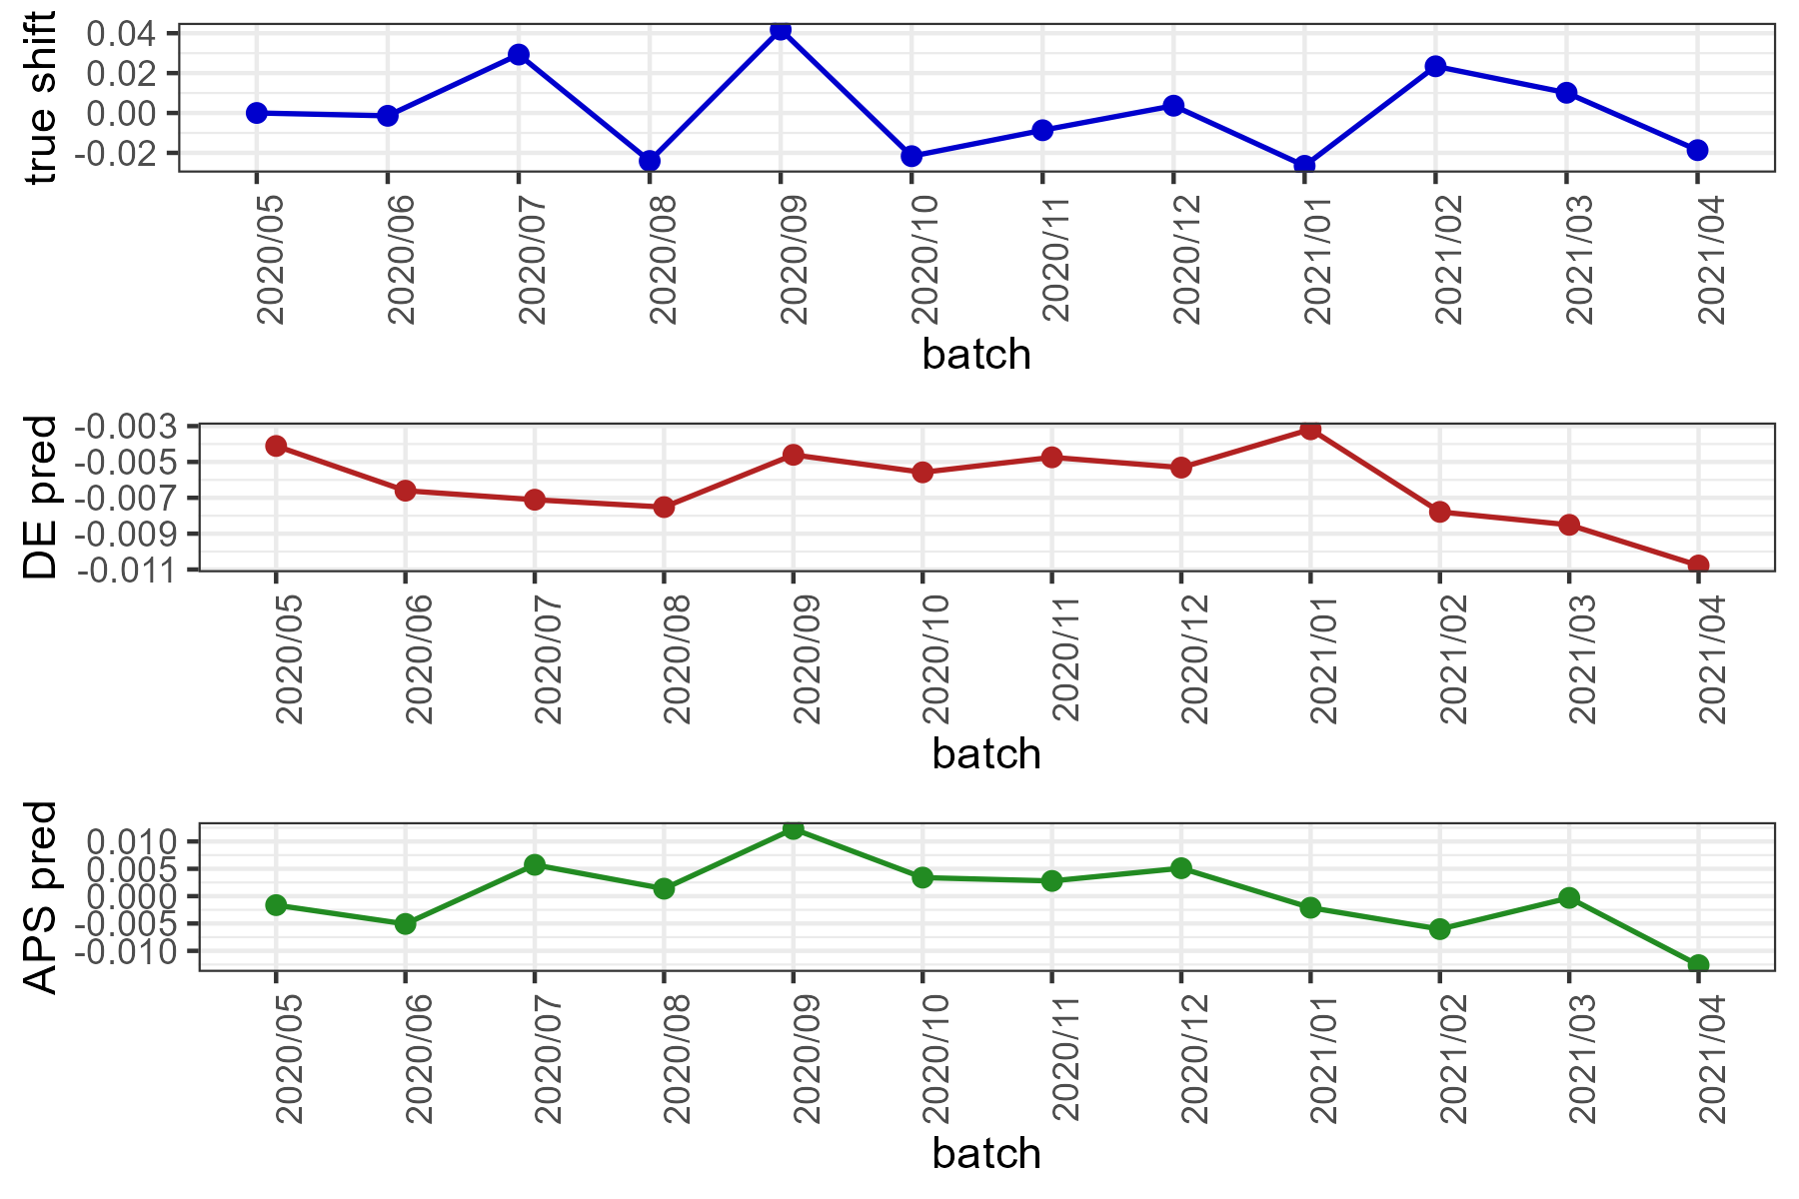

Shift prediction
*AVR score is the metric performing slightly better in predicting the shifts.

Slide 21
Results Covid-19 data (recall, RF model)

Slide 22
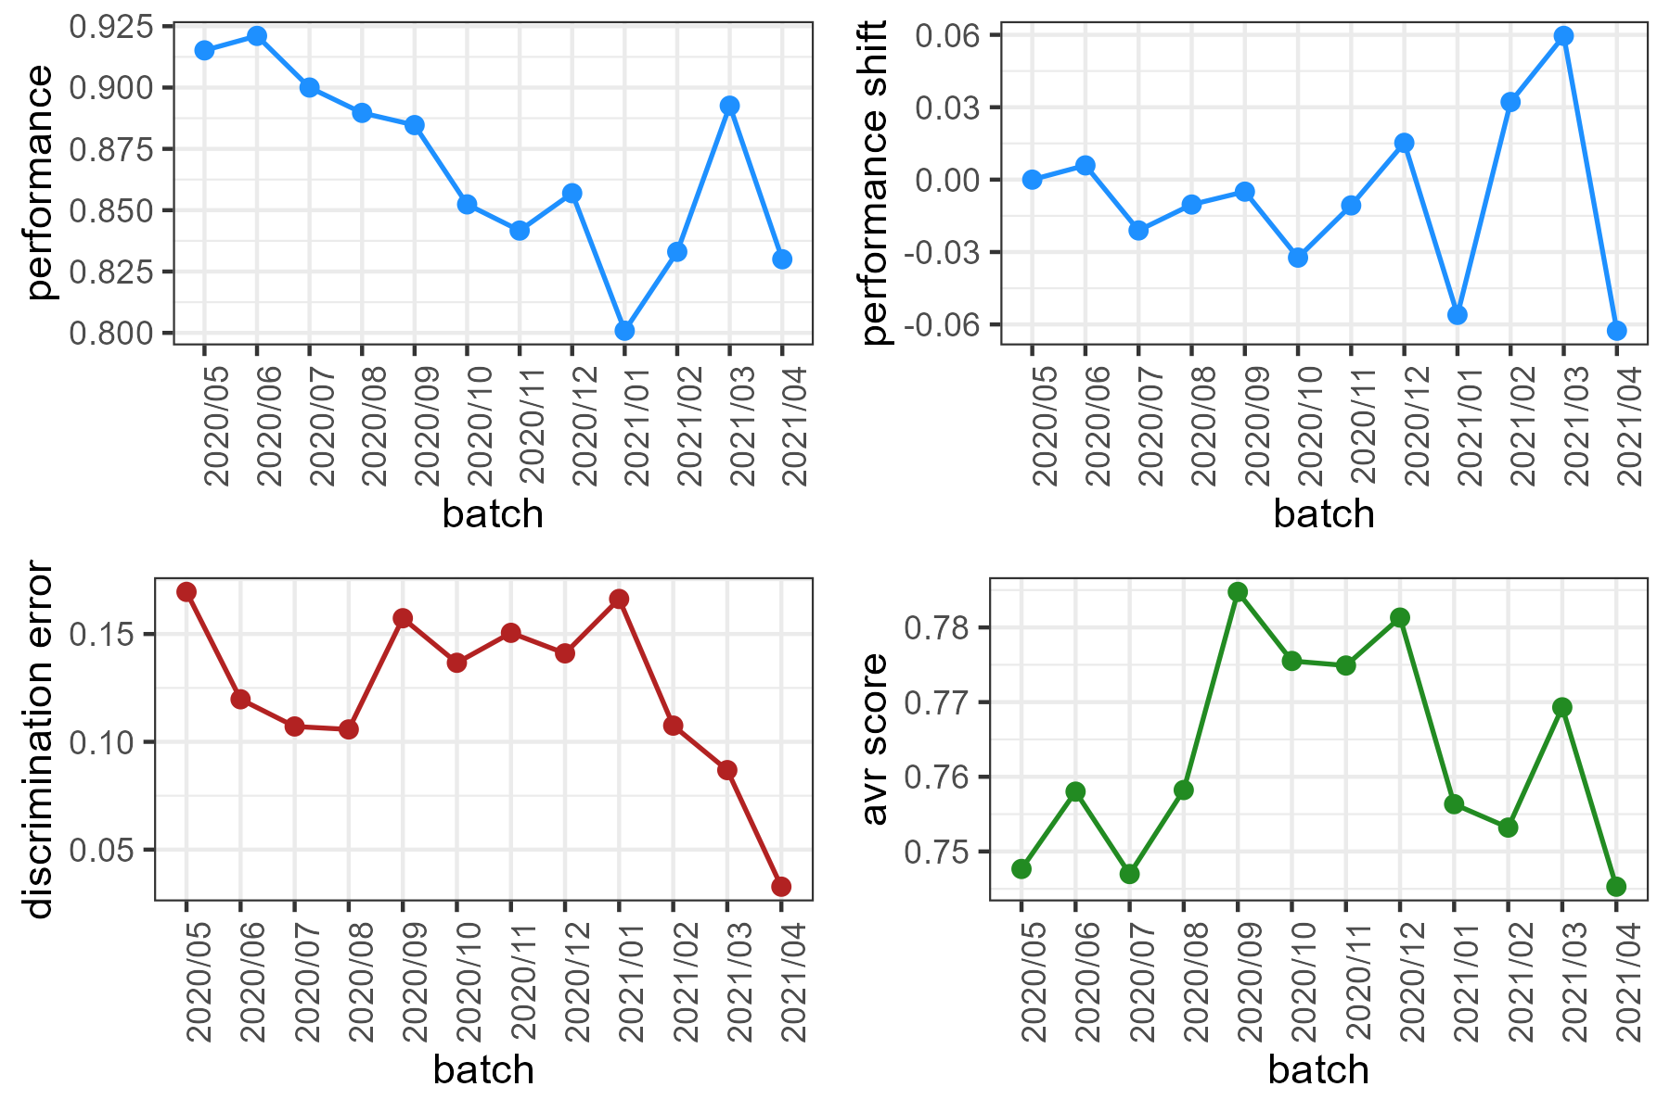
COVID-19 data (recall, RF model)
*recall assumed much higher values now. The trend is decreasing with a spike in the last batches.

Slide 23
Metrics computation
*When DE decreases, the model easily split source data with target data, that is the domain are very different (indicates shift).
Same for the average certainty score.

Slide 24
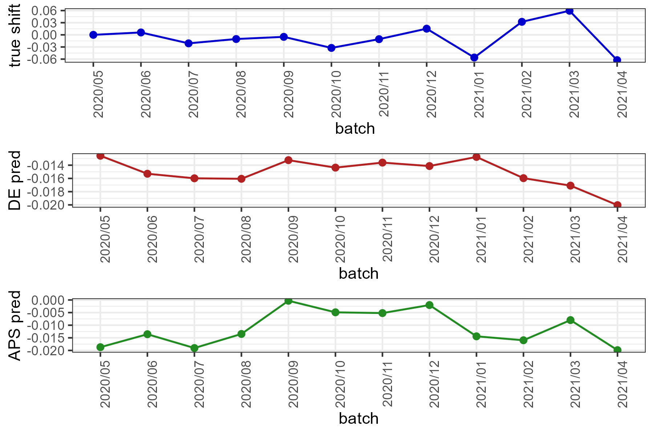

Shift prediction
Slightly better predictions using the AVR metric.

